Slide 1
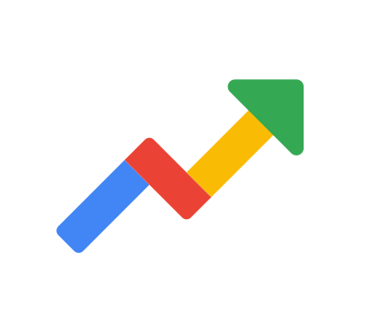
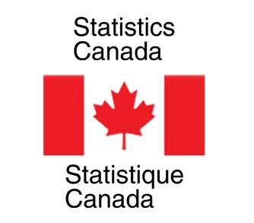

Nowcasting Macroeconomic Indicators using Google Trends
Presented By:
Aishwarya Sharma
Harpreet Kaur
Jagdeep Brar
Date: 31st May, 2022
IMAGE: https://wallpapersafari.com/w/swTjG4

Slide 2
OUTLINE
INTRODUCTION TO TEAM AND CLIENT
OVERVIEW OF PROJECT
DATA SET
METHODOLOGY
OBTAINED RESULTS
ROADBLOCKS
LEARNINGS AND FUTURE PLANS
1
2
3
4
5
6
7

Slide 3
Introduction
To Team

Slide 4
AISHWARYA SHARMA
Bachelors in Computer Science
Former Software Developer in Hewlett Packard Enterprise (HPE)
Passion for data and loves to play guitar in free time

Slide 5
JAGDEEP BRAR
Ph.D. in Applied Mathematics
Worked on Credit Risk Management Projects as
a Postdoc
Likes model fitting and cooking!!

Slide 6
HARPREET KAUR
Gold Medalist in Applied Mathematics
Former Software engineer
Love hiking, making and tinkering

Slide 7
Introduction
To Clients
Statistics
Canada

Slide 8

NICK NEWSTEAD
Economist, Sociologist
Data Exploration and Integration
Strong Data Science Background

Slide 9
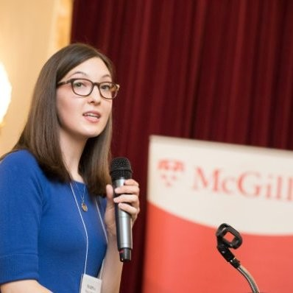
MARINA SMAILES
Senior Analyst
Data Exploration and Integration Lab
Microdata, Demographic Analysis

Slide 10

OVERVIEW OF PROJECT
Economic indicators are crucial indicators for a country`s policy and decision making but information contains a lag.

Slide 11
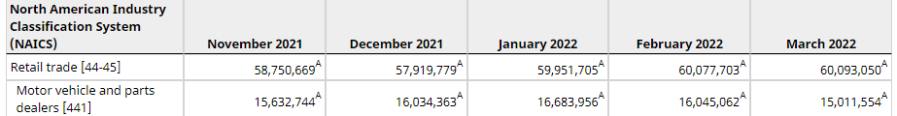
What does a lag within information means?
Retail Trade Sales (RTS) monthly (x 1,000)
Unreleased values of April 2022, May 2022 with gap of 2months.
Solution: Use Google Trends feature of current period real-time information to estimate current period indicators of interest.

Slide 12
What makes Google Trends a powerful tool for economic predictions?
Economic activity is changing rapidly and search behaviour can be informative when they are latest and in raw form.
Shows how frequently a given search term is entered into Google’s search engine relative to the site’s total search volume over a given period of time.
Compares the search volume of different queries over time within different interest and regions.

Slide 13
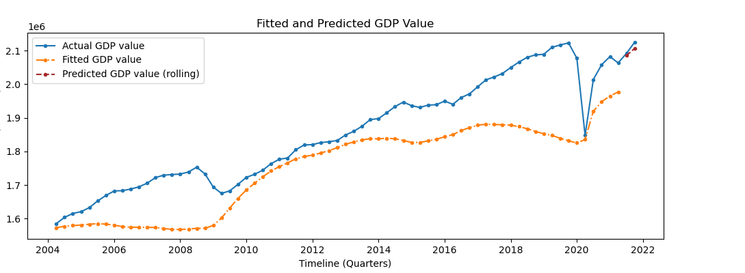
Why use Google Trends over historical time series data?
Figure _ : GDP fitted and predicted value using historical time series data

Slide 14
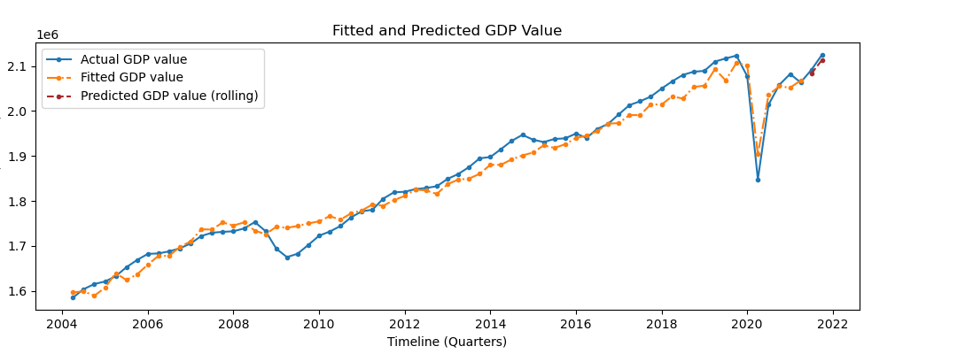
Figure _ : GDP fitted and predicted value with Google trends

Slide 15
OBJECTIVE
Nowcast quarterly Gross Domestic Product (GDP)
Nowcast monthly retail trade sales
Nowcast monthly retail E-commerce sales
Using related queries, topics, keywords of different industrial categories to capture business cycles for economic factors.

Slide 16
Why nowcasting not forescasting?
‘Nowcasting’ (or “predicting the present”) ; Choi and Varian
Nowcasting
Forecasting
Short-time forecasting.
Understanding current situation.
Long-time forecasting.
Estimation of future condition.
Notes:
> horizon of +0-6h
i.e, one year, a decade, etc.
Nowcasting is fact-based, focuses on the known and knowable, and therefore avoids forecasting.
Nowcasting is the economic discipline of determining a trend or a trend reversal objectively in real time. Nowcasting is the basis of a robust decision-making process
Based on quantitative data and Normally based on qualitative data

Slide 17
DATASET
Statistics Canada’s historical time series data for the indicators.
Google Trends extract in real time for different macroeconomic indicators as per the related queries, topics, and keywords.
Google Trends data available from the year 2004 onwards.

Slide 18
Statistics Canada Data
Economic Indicator | Timeline | Frequency
Retail trade sales | 1991-2022 | Monthly
E-commerce sales | 2016-2022 | Monthly
GDP | 1997-2021 | Quarterly
Selected Data for Analysis
Economic Indicator | Timeline | Frequency | Num. of observations | Num. of predictors (trends)
Retail trade sales | 2004-2022 | Monthly | 217 | 396
E-commerce sales | 2016-2022 | Monthly | 74 | 31
GDP | 2004-2022 | Quarterly | 72 | 446

Slide 19
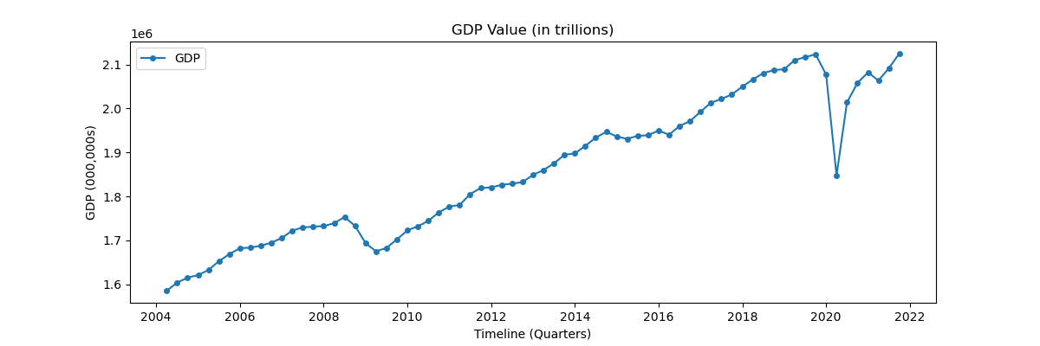
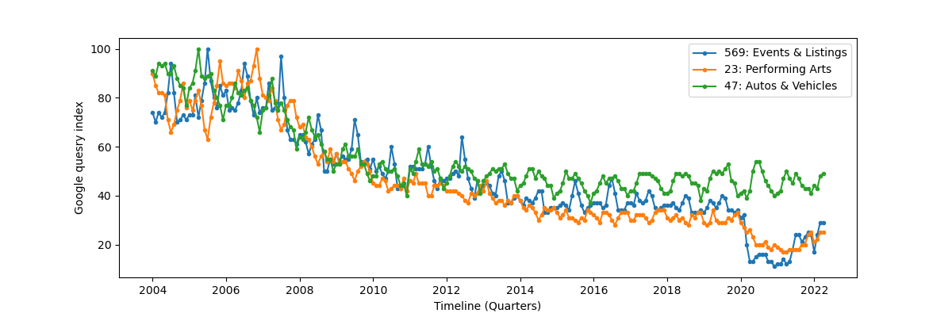
GDP time series
Google Trends time series

Slide 20
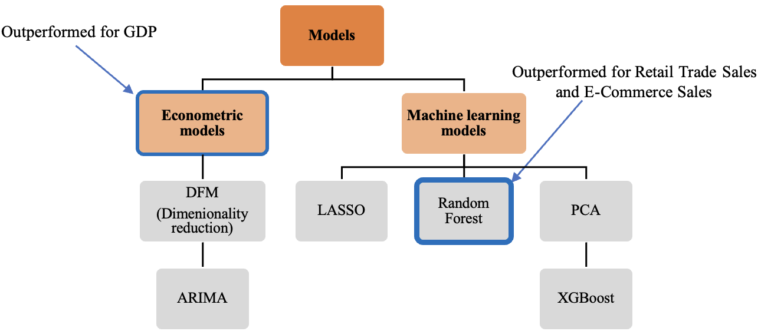
METHODOLOGY
Stationary Time Series

